Slide 1
An Empirical Evaluation of Deep-Learning and Machine Learning Approaches for Stock Price Prediction
By Al-Fahad Abdul-Mumuni

Slide 2
Aims
Evaluate the effect of different stock price representations on model performance.
Evaluate and compare the empirical performance of three classification models for stock price prediction.
Evaluate the ability of predictive models to generalize to non-training stocks.

Slide 3
Methods: Empirical & Statistical Evaluation
Statistical Evaluation
Evaluate accuracy of classification model based on typical statistical analysis used in classification tasks.
Empirical Evaluation
Trading strategy based on buy and sell signals generated by each classification model

Slide 4
Statistical Evaluation
Metrics used to evaluate the performance of the predictive classification models are standard.
Implemented in much of the existing literature (Cavalcante et al.2016) .
*AUC metrics was also utilized

Slide 5
Empirical Evaluation
Trading simulation based upon buy/sell signals generated by the classification models.
Evaluated the performance using empirical evaluation metrics taken from other papers (Long et al, 2019), (Shynkevich et al, 2017).
*Maximum Drawdown was aslo used to evaluate predictive classifcation models empirically.

Slide 6
Models
Deep-Learning Models
Convolutional Neural Network (CNN)
Machine-Learning Models
Support Vector Machine (SVM)
Random Forest Classifier (RFC)

Slide 7
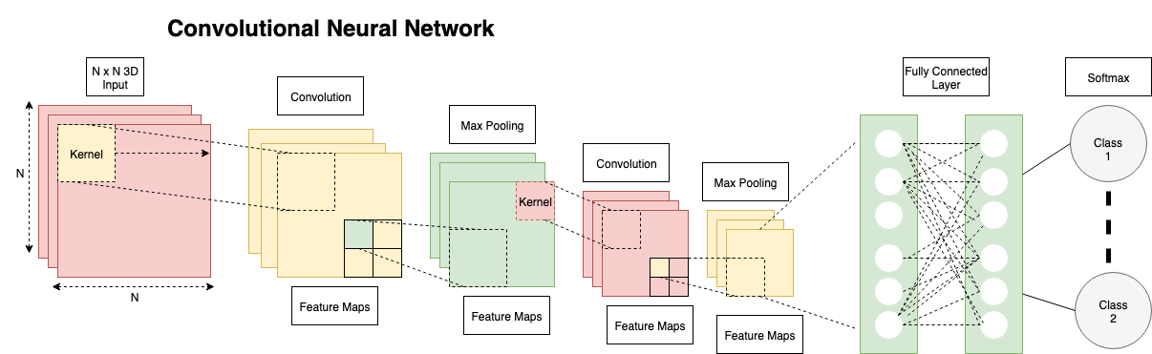
Convolution Neural Network
Typically 3 types of layers
Convolutional Layer
Pooling Layer
Fully connected layer

Slide 8
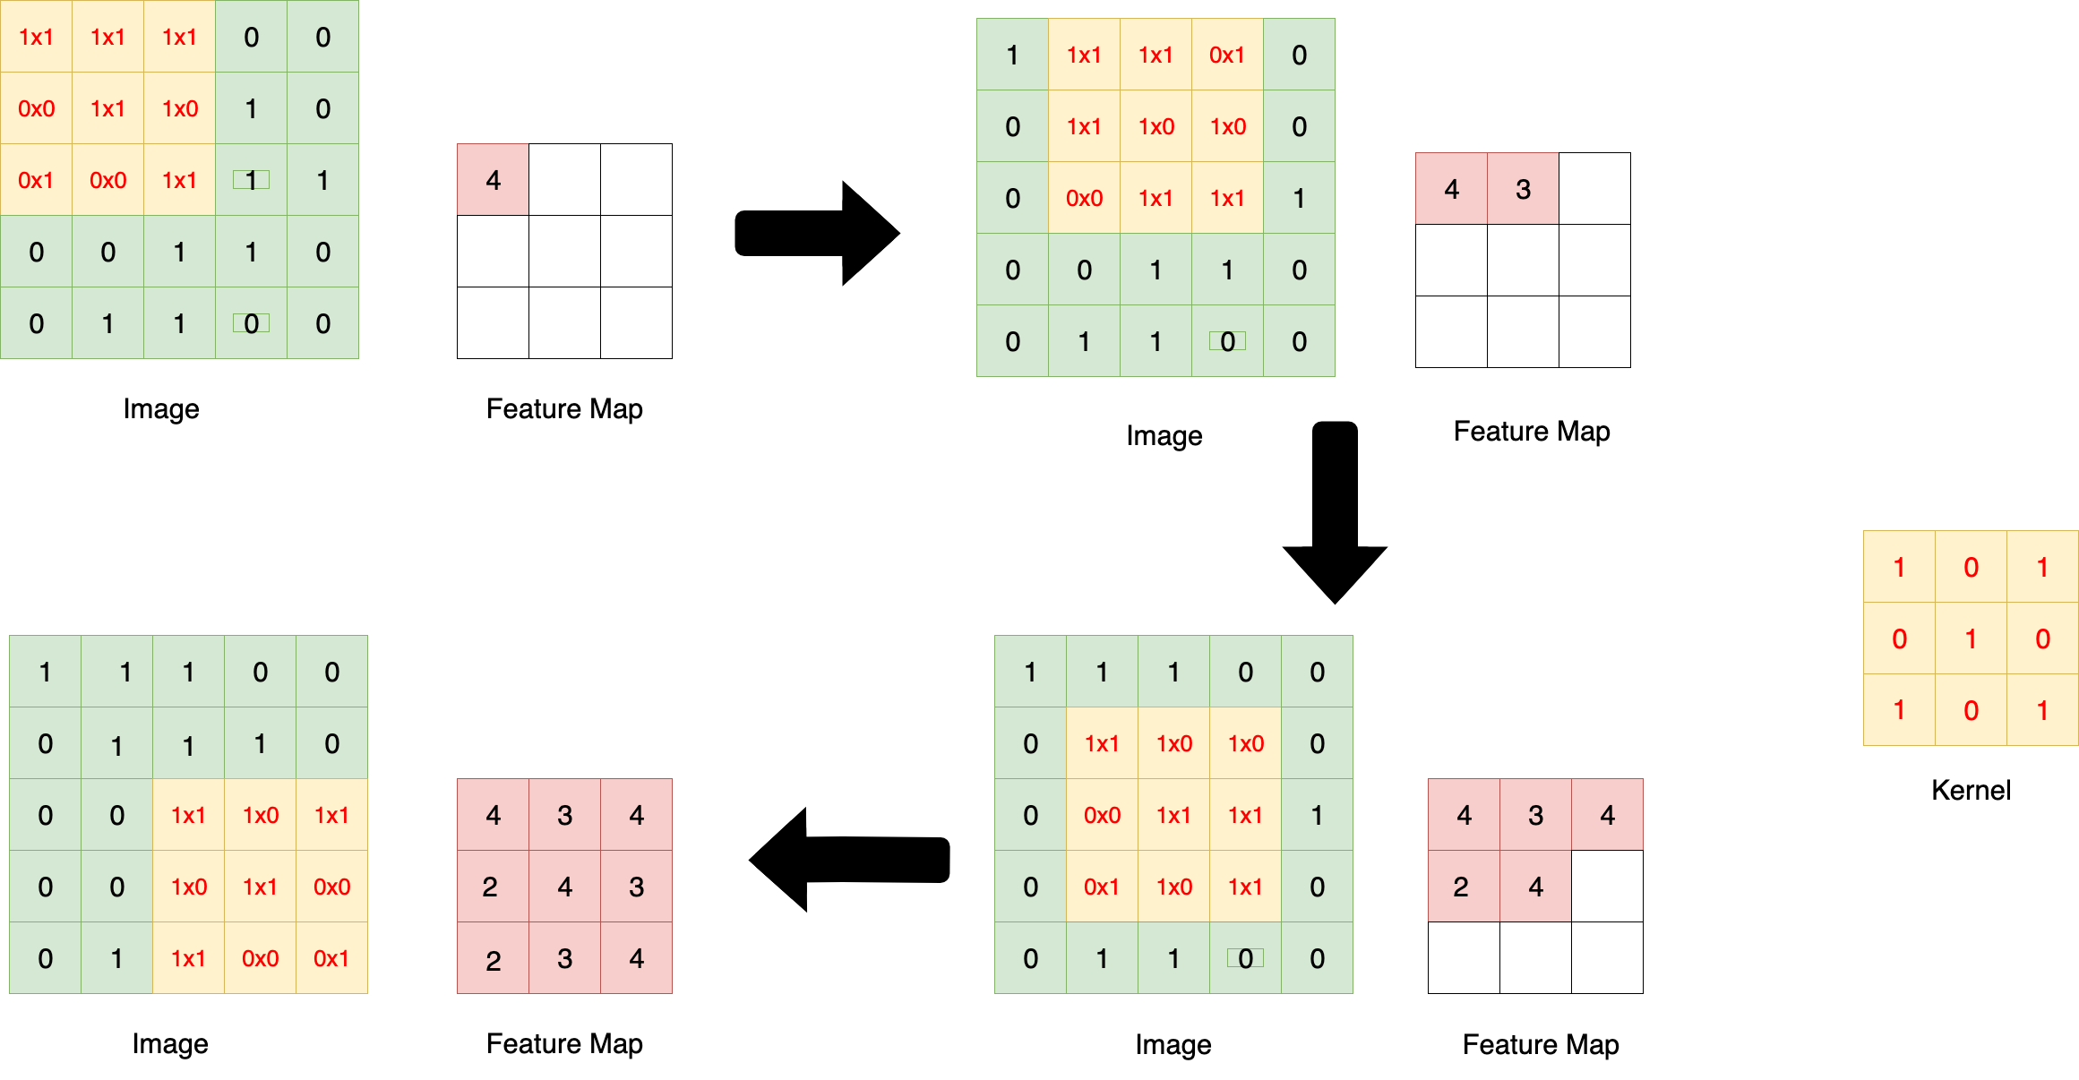
Convolution Operation
Matrix multiplication over original image, and successive feature maps.
Kernel convolves over the image/feature image.
Each kernel is able to identify different significant features in image/feature map.
While maintaining spatial relationships.

Slide 9
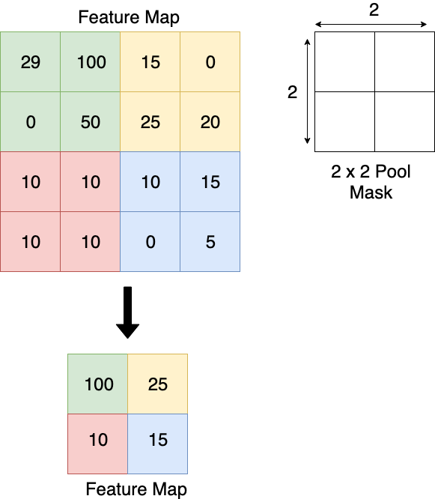
Pooling Operation
Pooling mask convolves over successive feature maps
Pooling typically takes the maximal or average value of the pixels in the masks’ coverage area
Reduces size of feature maps, prevents overfitting.
Reduces number of parameters learned and computation.

Slide 10
1D-Convolution Neural Network
Implemented a 1d CNN, essentially an identical topology to 2d.
Convolution and pooling operation occurs in a single dimension, in contrast to the convolution in 2d (and greater dimensions).

Slide 11
Support Vector Machine (SVM)
Maximal margin classifier, aims to separate class whilst minimizing generalization error.
Done by determining the optimal weights and bias values through the minimization of the following expression:

Slide 12
Random Forest Classifier (RF)
Collection of de-correlated decision trees ensembled to classify an exemplar
Typically implement a majority vote, to classify an exemplar.
Resistant to overfitting.

Slide 13
Results
Comparison of data representations
Raw
Technical Indicator
Combination
Raw
Combination

Slide 14
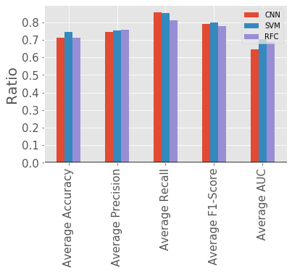
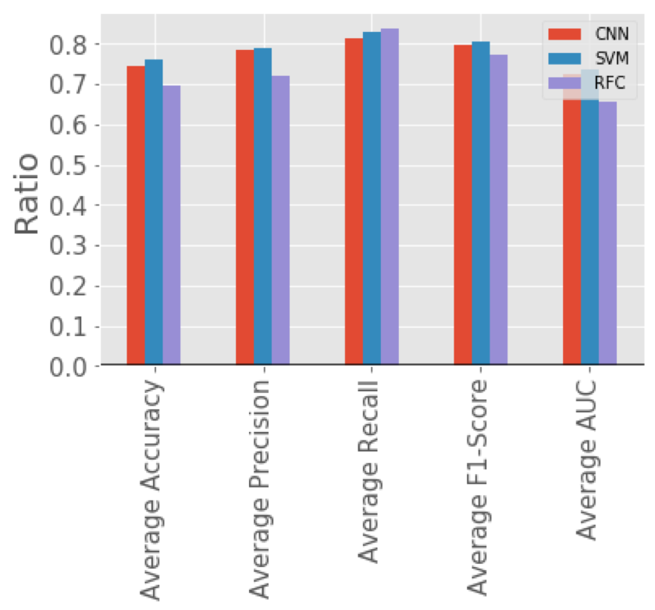
Results
Comparison of data representations
Raw
Technical Indicator
Combination
Technical Indicator
Combination

Slide 15
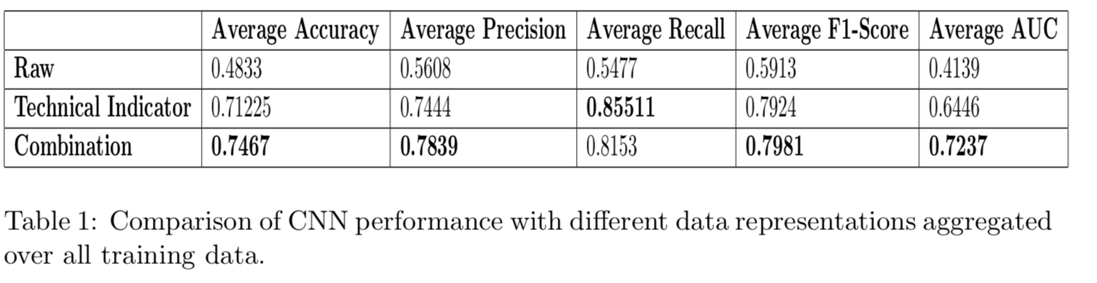
Results
Comparison of data representations
Raw
Technical Indicator
Combination

Slide 16
Results
2. Comparison of CNN, SVM, RF on training stocks out of sample:
Statistical Evaluation
Empirical Evaluation

Slide 17
Results
2. Comparison of CNN, SVM, RF on training stocks out of sample:
Statistical Evaluation

Slide 18
Results
2. Comparison of CNN, SVM, RF on training stocks out of sample:
Empirical Evaluation

Slide 19
Results
3. Comparison of CNN, SVM, RF on non-training stocks out of sample:
Statistical Evaluation
Empirical Evaluation

